Slide 1
Proposal to Assist
Kenneth Cole in Evaluating Potential Strategic Options
September 24, 2001

Slide 2
Table of Contents
  Project Background
  Project Objectives
  Project Approach
  Qualifications
  Staffing and Fees
  Appendix A - Resumes
  Appendix B - General Terms and Conditions

Slide 3
Project Background

Slide 4
Project Background
Current Situation
Sells shoes, clothing, and accessories for women, men and children under the Kenneth Cole New York, Reaction Kenneth Cole, and Unlisted brand names
Utilizes a variety of channels including wholesale, specialty retail stores, outlet stores, mail order catalogs, e-business, and licensing
Focuses on maintaining brand equity by constraining distribution in the short term rather than participating in price-driven promotions
Markets its products in more than 4,100 department and specialty store locations
Operates 69 specialty retail and outlet stores and plans to open between 7 to 12 stores in 2001
Offers both basic and fashion styles with basic styles supported to an open stock program
Strategic Objectives
To aggressively grow Kenneth Cole Productions, Inc.’s sales and profits by between 20 and 25%
To build on the strength of its lifestyle brand franchise
To enhance the brands’ fashion image and authority
To quickly react to changes in consumer preferences and the economic environment
To provide credible sales and earnings projections to the investment community
Sales and earnings growth in 2001have not met company or investor expectations
Kenneth Cole has been unable to leverage infrastructure investments and increased selling, general, and administrative expenses
Economic forecasts for the remainder of 2001 indicate that soft economic conditions, retail consolidation, and price pressure will continue

Slide 5
Project Objectives

Slide 6
Project Objectives
  To identify potential growth opportunities for Kenneth Cole in all channels -- wholesale, consumer direct, and licensing / international
  To prioritize the potential growth opportunities and to identify a set of key strategic initiatives based on the overall requirements and objectives set by Kenneth Cole Productions, Inc.
  To generate the financial baseline for the selected strategic initiatives, and model the implications of their key positioning requirements
  To define the next steps and required work to ensure a seamless transition to implementation
  To develop an approach for strategic planning for Kenneth Cole that can be leveraged by senior management going forward

Slide 7
Project Approach

Slide 8
PricewaterhouseCoopers Approach
PwC’s approach combines expertise in Strategy, Organization, Process, IT, and Finance to provide an integrated solution that minimizes the risks associated with the implementation of new strategic initiatives. As part of this engagement we will focus on the strategic and financial issues presented by the new initiatives. However, we will also address at a very high level key process, organization and information technology issues.
Process
What process capabilities are required to support expansion into new channels?
What available alternatives will close the gap?
What will be the anticipated results from adding new capabilities?
Can these capabilities be
leveraged by the existing
organization?
Information Technology
  What additional capabilities are required to support expansion into new channels / businesses?
  What is the cost/benefit analysis for these capabilities?
  Can these capabilities be leveraged by the existing organization?
Strategy
  What is the ideal positioning for
  the brands?
  Are the desired markets attractive?
  Can we differentiate ourselves in the marketplace?
  Will this enhance brand equity?
Organization
Can the new initiatives be
supported by the existing organizational structure?
What investment in human resources is required to successfully implement the new concept?
How will these initiatives impact current compensation, training, succession planning, and recruiting processes
Finance
  What is the anticipated return from the new initiatives?
  What are the financial implications of the concept on the existing business?
  What are the risks and returns associated with the concept?
  What investments are required?

Slide 9
Project Workplan
This project requires a three phased approach. In the first phase, the growth opportunities for Kenneth Cole are identified. In the second phase, those initiatives are evaluated based on specific criteria including anticipated financial performance and strategic fit. During this phase, a subset of strategic initiatives are identified for further study. In the last phase, proformas are developed for the strategic initiatives and next steps are identified. In addition, during the process, a formalized strategic planning approach is developed and documented.
Determine potential
growth opportunties
Evaluate and prioritize growth opportunies
Determine impact and identify next steps
Develop approach for strategic planning
3 - 4 weeks
3 - 4 weeks
4 weeks
This proposal was developed with the understanding that PwC will have access to internal documents regarding customer information and current financial performance, and internal process benchmarks. In preparing this proposal, we have not assumed costs for additional primary research or for any purchased secondary research, although this may be required.

Slide 10
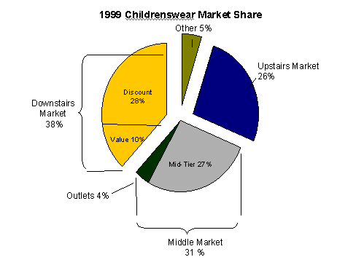
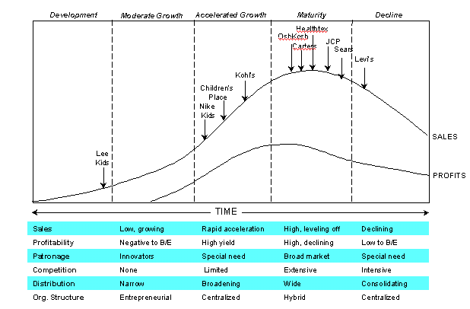
Project Approach
DETERMINE POTENTIAL OPPORTUNITIES
Sample Deliverables
Objective: To initiate project, confirm scope, and identify a list of potential strategic opportunities
Timing: between 3 to 4 weeks
Key Tasks and Considerations:
  Initiate the project and confirm scope/objectives
  Interview key executives
  Review current research on US men’s and women’s apparel markets across department, discount, and specialty stores
  Review target customer groups based on Kenneth Cole’s current information
  Review current channel positioning and competitive landscape based on Kenneth Cole’s current data
  Conduct workshop to determine potential opportunities
Key Deliverables:
  Project plan
  Market overview
  List of potential opportunities
Market Size
Market Maturity Curve

Slide 11
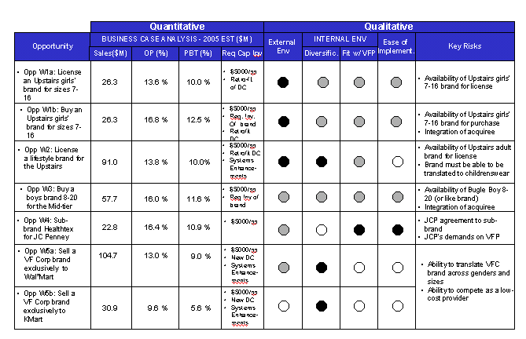
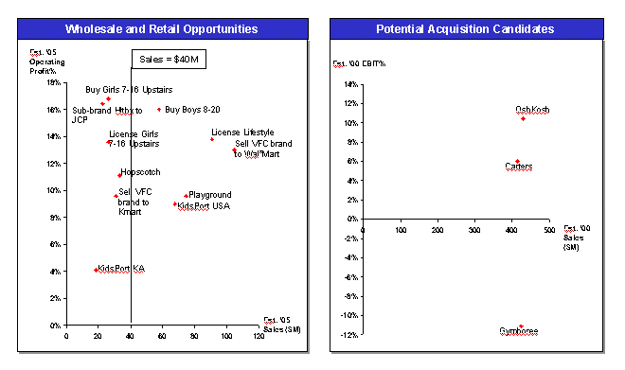
Project Approach
EVALUATE GROWTH OPPORTUNIES
Sample Deliverables
Objective: To evaluate the identified opportunities based on selected criteria and to select the strategic initiatives for further evaluation
Timing: between 3 to 4 weeks
Key Tasks and Considerations
  Determine / validate selection criteria, such as strategic fit, financial goals, etc.
  Determine anticipated positioning for opportunities: customers, competitors, product, and key appeals. Evaluate against current positioning
  Assess current operational and organizational capabilities against baseline requirements
  Develop initial financial baselines for each initiative:
    Estimate sales volume and gross margin based on market share/industry averages/Kenneth Cole’s current performance measures
    Identify any significant capital investments
  Prioritize initiatives based on selection criteria and additional input from executives
  Report out results of evaluation to senior management and select initiatives for further evaluation
Key Deliverables
  Summary of evaluation for growth opportunities
  Selection of key initiatives for further evaluation (2 - 3 initiatives)
Opportunity Evaluation Matrix
Opportunity Evaluation Summary

Slide 12
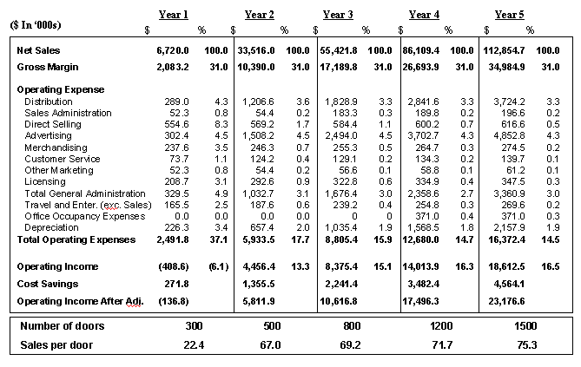
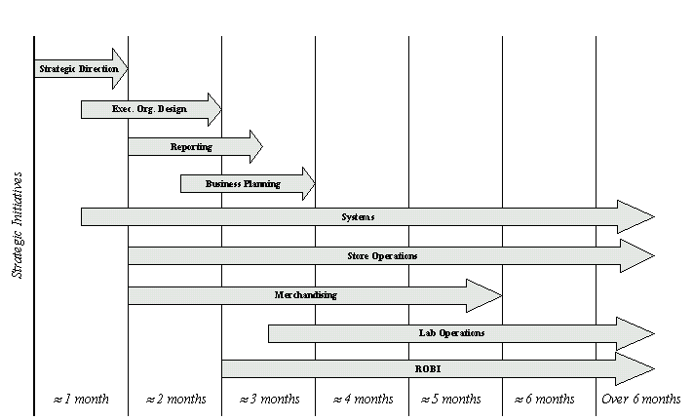
Project Approach
DETERMINE FINANCIAL IMPACT AND IDENTIFY NEXT STEPS
Sample Deliverables
Objective: To generate a set of financial proformas for the selected strategic initiatives. To define the next steps and required work to ensure a successful implementation
Timing: 4 weeks
Key Tasks and Considerations
  Develop a framework for implementation and a high-level understanding of the costs associated with implementation
  Develop financial proformas and scenarios for each initiative
  Analyze financial / strategic implications of the initiatives relative to Kenneth Cole’s overall strategy
  Prepare a business case for presentation to the board
  Meet with the board to review business case and facilitate management decisions
Key Deliverables
  Business Case for 2 to 3 Strategic Initiatives
  Next Steps
Financial Proforma
Implementation Framework

Slide 13
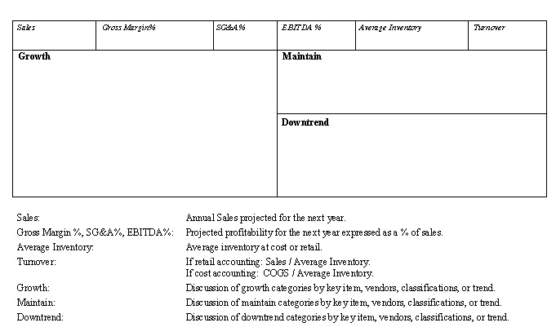
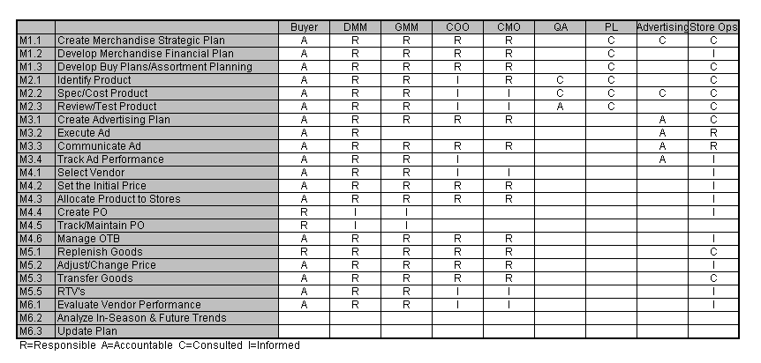
Project Approach
DEVELOP STRATEGIC PLANNING APPROACH
Sample Deliverables
Objective: To develop an ongoing approach to strategic planning that will allow Kenneth Cole to track its performance against plan and to make course corrections as required
Timing: 4 weeks
Key Tasks and Considerations:
  Develop a set of performance targets
  Establish timelines for ongoing analysis
  Set guidelines for responsibility and accountabilities
  Develop high-level process to track performance against current strategic plan and to make adjustments as required
Key Deliverables:
  Key performance metrics
  Ongoing strategic planning approach
  High-level organizational responsibilities
Business Planning Template
Responsibility Matrix

Slide 14
Qualifications

Slide 15
Uniquely Qualified
PricewaterhouseCoopers is uniquely qualified to assist Kenneth Cole in its efforts. We have:
  Retail and Apparel - specific experience with a large varied client base
  Proprietary databases and thought leadership through our Retail Intelligence System®, and retail / apparel research library
  Collaborative team-oriented approach
Research and Intelligence
Strategy
Business Process
IT
Retail Intelligence System
Economic Analysis and forecasts
Industry Baseline Analysis
Site-Selection Research
Consumer Research
Due Diligence Assessments
Strategic Planning
Market Positioning
Operating Strategy Development
International Strategy Development
Organizational Strategy Development
Performance Measurement
New Concept/ Market Development
Business Turnaround Strategy
Financial Scenario Modeling
Business Process Assessment
Performance Measurement
Benchmarking
Process Reengineering
Revenue Generation
Best Practices
Value Based Management
Strategic Systems Review
Strategic Development
Packaged Software Assessments and Selection
Packaged Software Implementation Support and Project Management
Distribution Systems Planning
Operations Review
Strategic Outlook Conference
Spring Management Conference
Retail Yearbook
Retail Preview
Intelligence Update
The Retail Economist
Critical Issues

Slide 16
Selected Apparel Clients
Selected Apparel Clients
Ann Taylor
Bergdorf Goodman
Calvin Klein
Carter’s
Eddie Bauer
J.C. Penney
J. Jill
Levi’s
L.L. Bean
Neiman Marcus
Nordstrom
Nine West
Nike
OshKosh
Ralph Lauren/Polo
Saks Fifth Avenue
The GAP
The Limited
Talbot’s
Tommy Hilfiger
Warnaco

Slide 17
Project Citation
KEY BUSINESS ISSUES:
  Additional growth strategies outside of current wholesale market
  Expose brand to new customers
  Create/leverage new brand to reach additional customers in different channels and to round out current portfolio
  Leverage current infrastructure, create opportunities to upgrade current processes and systems
SOLUTION APPROACH:
  Determine potential strategic growth options
  Develop a set of criteria to measure options
  Develop performance models for each option
  Identify impact on current organization
  Determine additional infrastructure requirements including organizational, technology and distribution
  Prioritize strategic initiatives
  Determine go-forward initiatives and develop high level execution plans
Large Global Apparel Manufacturer
RESULTS:
  Comprehensive list of initiatives evaluated against set criteria
  Approval of board to go-forward on chosen initiatives
  Five year business plan that meets company expectations for profitability and growth
  Defined impact on existing organization and strategies to mitigate risk

Slide 18
Project Citation
KEY BUSINESS ISSUES:
  Determine growth strategies for current private label brand outside of existing channel
  Expose brand to new customers and increase awareness
  Tailor assortment, determine key sub-brands to go forward with while maintaining consistency and integrity of brand
  Leverage current infrastructure when possible and identify issues with existing infrastructure support
SOLUTION APPROACH:
  Determine potential external growth options
  Interview potential customers and determine interest level
  Develop high level merchandise assortments and pricing strategies
  Determine infrastructure requirements including organizational, technology and distribution
  Develop performance models for each option
  Determine go-forward initiatives and determine next steps
Large Global Apparel Manufacturer/Retailer
RESULTS:
  Sales and marketing strategy for identified brand
  Supply chain, organizational, and technology requirements to support strategy
  List of potential interested external customers
  5 year performance estimates for strategy that met with client’s goals and objectives

Slide 19
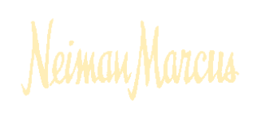
Project Citation
KEY BUSINESS ISSUES:
  Update strategy to respond to changes in competitive intensity
  Optimal organizational structure and processes to support new positioning
  Tailor store assortments to local market needs while leveraging infrastructure
SOLUTION APPROACH:
  Extensive consumer research to identify competitive strengths and opportunities
  Work with senior team to focus organization through strategic initiatives and internal support
  Assess merchandising opportunities and develop integrated systems to facilitate local assortments
RESULTS:
  New mission statement for organization
  Comprehensive set of strategic initiatives
  Merchandising process reengineered to plan, allocate, and market locally while minimizing disruptions to existing staff
  Required changes to functional systems documented to facilitate implementation

Slide 20

Project Citation
KEY BUSINESS ISSUES:
  Additional growth strategies outside of traditional catalog retailing
  Leverage existing customer base
  Coordinate all channels, including retail stores, catalog, and internet
  Leverage current infrastructure
SOLUTION APPROACH:
  Develop retail strategy and concept
  Partner with branding and store design firms to ensure that the strategy and concept is accurately incorporated into final deliverables
  Develop financial models
  Identify impact on current organization
  Determine additional
  infrastructure requirements
  Develop detailed execution plans
RESULTS:
  Viable strategic positioning and concept
  First store opened in 2000. LL Bean plans to open additional stores during 2001
  Concept to double sales volume over seven years
  Five year business plan that exceeds company hurdle rates for IRR
  Minimal impact to organization in early years

Slide 21
Staffing and Fees

Slide 22
Proposed Project Team
We propose an integrated project team comprised of Kenneth Cole executives and PricewaterhouseCoopers professionals representing the full range of relevant industry and functional areas of expertise.
Project Sponsor
Kenneth Cole Leadership Team
Chairman
Kenneth Cole
PwC Relationship Partner
Board of Directors
Herb Kleinberger
Global Retail Lead Partner
Strategic Change Retail
PwC Project Partner
Jennifer Crites
Partner
Strategic Change Retail
Project Manager
Kari LePage
Principal Consultant
Strategic Change Retail
Project Team
Melanie Sy Anthony Ackil
Senior Consultant Consultant
Strategic Change Strategic Change Retail Retail

Slide 23
Project Fees
PricewaterhouseCoopers welcomes the opportunity to partner with Kenneth Cole on this important engagement. After thorough consideration of the project scope and staffing requirements, we have estimated the total professional fees for this engagement to be $ 350,000. These fees cover the deliverables and tasks outlined in Phase 1: Determine Potential Opportunities through Phase 3: Determine Financial Impact and Identify Next Steps, and Develop Strategic Planning Approach.
This is a not-to-exceed quote, provided there is no change in project scope. We expect the project to be completed within 10 - 12 weeks of the formal starting date, assuming sufficient client involvement and access to required information.
Kenneth Cole will also be responsible for the actual cost of out-of-pocket expenses such as travel and report preparation. These costs are estimated not to exceed 15% to 20% of professional fees. Professional fees and expenses are invoiced monthly and are payable with Net 30-day terms.
PricewaterhouseCoopers thanks you for inviting us to present our proposal for this exciting engagement. We would like to express our high level of interest in partnering with Kenneth Cole to pursue these opportunities further.

Slide 24
Appendix A - Resumes

Slide 25
Herb Kleinberger
Mr. Kleinberger is the Global Retail Leader at PricewaterhouseCoopers. Mr. Kleinberger specializes in business process improvement in retail and apparel companies. He works with clients to evaluate and transform their operations, organizations and systems in order to improve customer service and profitability. Mr. Kleinberger's consulting activities have focused on the buying process, merchandise planning and distribution, supply chain management and performance measurement. He has also directed strategic positioning studies, acquisition reviews and cost reduction studies.
In his leadership role, he is responsible for coordinating practice strategy and service delivery within the retail sector globally. He also serves as e-Business transformation leader with our Consumer and Industrial Products market cluster. In this capacity he has been involved in our B2C and B2B go-to-arket strategy and service offer development.
Highlights of Mr. Kleinberger's consulting activities have included:
  Planning for the consolidation of two major multi-divisional retail companies' central office activities and management information systems.
  Preparing an operating and reengineering plan for shifting a major mass merchandising chain from store pull to centralized merchandising and identifying productivity improvements that could be made in distribution and inventory management information systems.
  Directing a business process reengineering study at a major specialty apparel chain involving merchandising, distribution and inventory management activities. Focused on aligning business activities with critical success factors.
  Developing a comprehensive strategic implementation systems plan for one of the nation's largest retail companies. This plan was tied into a major turnaround and restructuring of the business.
  Developing assorted B2C e-Business strategies for various retail and consumer-oriented companies.
  Directing the worldwide evaluation of the operations, processes and use of information technology at a multinational retail holding company. Results were used to drive the preparation of strategic changes at each operating company.

Slide 26
Herb Kleinberger (continued)
Prior to joining PwC, Mr. Kleinberger was a consultant for Dennison TRG, Inc. where he worked with retailers to strengthen their merchandising and inventory management capabilities. Previously, he served as Vice President and Treasurer of Retail Strategies, Inc., a retail consulting firm.
Mr. Kleinberger has published numerous papers with leading associations and is a frequent speaker at industry conferences including National Retail Federation, Retail Systems and eRetailing.
He is a member of the Retail Financial Executives Association, the Wharton Club of New York and the Institute for the Certification of Computer Professionals.

Slide 27
Jennifer Crites
Ms. Crites is a Partner with PricewaterhouseCoopers located in New York. Ms. Crites has over 15 years experience in the retail and apparel industry, both as a consultant and as a member of senior management. She specializes in strategy development and implementation, organizational change and process improvement in the areas of brand positioning, market penetration and operations. Selected professional experience includes:
  For a leading designer off-price retailer, led the assessment and validation of its business strategy in terms of its core customer, merchandise offering and vendor matrix, pricing strategy, store location portfolio and operations and marketing/promotion activities;
  For an exclusive designer eyewear brand, identified performance improvement and growth opportunities in both the wholesale and retail divisions, including a comprehensive assessment of sales, marketing, merchandising, operations, finance and hr;
  For a leading European designer, led a sales/brand penetration optimization study to assess various wholesale and retail distribution and operating scenarios;
  For a branded childrenswear manufacturer, performed a comprehensive evaluation of strategic wholesale and retail expansion opportunities;
  For a major intimate and casualwear apparel manufacturer, performed a comprehensive assessment of strategic restructuring alternatives across all divisions, including brand positioning, demand planning and forecasting, manufacturing processes, inventory management, etc.

Slide 28
Jennifer Crites (continued)
Ms. Crites recently rejoined the New York office of PricewaterhouseCoopers from Calvin Klein, Inc., where she was Senior Vice President of Retail and responsible for the company’s owned and franchised stores worldwide. Ms. Crites also held the position of Vice President of Strategic Planning while at Calvin Klein, Inc. and was instrumental in many of the company’s restructuring and global expansion initiatives for many of its wholesale businesses.
Prior to joining Calvin Klein, Inc., Ms. Crites was a Senior Manager with the Management Horizons a consulting division of Price Waterhouse LLP.
Ms. Crites also authored reports regarding relevant industry trends and critical issues and delivered presentations at many client and industry conferences.
Ms. Crites holds a MBA in marketing and finance from The Ohio State University, where she also earned a BSBA in accounting.

Slide 29
Kari LePage
Ms. LePage is a principal consultant in the CIP Retail Strategy Group based in NY,NY. She has experiences in both industry and consulting. She has specialized in strategy development/implementation, industry and competitive assessments, and organizational and process improvements. Selected professional experience includes:
  Led project for a large apparel wholesale and retail client that developed a positioning strategy for the brand. Led both quantitative and qualitative market research efforts, including demographic and psychographic profiling of the consumer. Evaluated competitor’s positioning and led both quantitative and qualitative benchmarking efforts, including competitive audits
  Managed project to develop a sales and marketing strategy for a private brand within a large apparel manufacturer. Developed performance models, merchandise assortments and pricing strategies. Helped determine viabilitity of brand within external arena. Determined infrastructure requirments to support external expansion
  Managed project for a large apparel manufacturer that identified and evaluated potential growth opportunities in both the wholesale and retail channels. Determined market segments, accounts and locations to target. Developed merchandise assortment and pricing strategies. Identified customer and marketing requirements. Determined additional infrastructure required including sales support, merchandising, distribution and systems adjustments
  Led a project to develop a restaurant concept for a consumer packaged goods company. Identified positioning for the new concept including customer, merchandise mix, pricing, and competitors. Developed a detailed financial plans to validate the concept. Defined execution and process requirements and developed implementation plans
  Determined the financial viability of a potential merger between several discount/department store operations. Developed operational strategy based on best practices for merchandising processes, identified supporting organizational structures and skill sets, and determined information technology required to support new processes
  Led a project to determine organizational structure for potential merger of two specialty retailers. Identified best practices for multi-divisional retailers and recommended potential solution. Identified transition management approach
  Developed a retail channel expansion/new store concept strategy for an apparel and sporting goods catalog company. Identified target customer, merchandise mix, primary and secondary competitors, and key areas of differentiation. Defined execution requirements, such as store size and layout, real estate strategy, in-store merchandising standards, pricing, customer service, and support systems (information technology, logistics, and human resources)

Slide 30
Kari LePage (continued)
  Led a project to develop a new children’s apparel concept. Tested viability of concept and identified positioning including target customer, merchandise mix and competitive positioning. Developed detailed financial plans to validate the concept. Defined execution and process requirements and identified gaps in current capabilities
  Led a business assessment of a homegoods/apparel retailer. Assessed long-term viability of concepts and recommended strategic positioning changes. Identified areas of opportunity in store size and layout, merchandise mix, pricing, customer service and support systems
  Led an assessment of potential business opportunities for a major specialty retailer. Provided analysis of economic trends, in-depth analysis of competitive set, as well as, customer acceptance and market forecasts
  Developed an operations model recommendation for a retailer of softgoods that included merchandising, store operations, staffing and financial models, and a high-level implementation plan
Prior to PricewaterhouseCoopers, Ms. LePage worked at the Gap, Inc., where she was a Director in the Strategic Planning department and managed the strategy development process of Gap/GapKids including the development of new merchandise categories. Participated in the development of the Old Navy brand including market, customer, merchandise and price positioning. Analyzed the repositioning of Banana Republic with respect to marketing
Ms. LePage holds a MBA from The Stern School of Business at NYU, New York, NY and a BA in Economics / Computer Science from Rutgers University, New Brunswick, NJ

Slide 31
Melanie Sy
Melanie Sy is a consultant in our Strategic Change Retail Practice. She has six years experience working in the Retail/Manufacturing industry with experience ranging from store-line to merchandising, where she was an assistant buyer. Her experience within apparel manufacturing ranges from design to production/sourcing for both knitwear and wovens. Select experiences include:
  Prepared and delivered 5 year Sourcing Strategy and Operational Plan to Directors of a $500m+ apparel/footwear and accessories manufacturer. Developed issue-based hypotheses across 5 phases of project: 1) Situation Assessment 2) Scenario Envisioning 3) Strategic Options 4) Operational Plan 5) Benefits Case. Identified end-to-end process and technology implications of project. Served as Industry Specialist regarding retailing and apparel manufacturing.
  Formulated, developed and evaluated 15+ expansion opportunities for a $500m+ childrenswear manufacturer, including wholesale and acquisition models. Led Wholesale Client Team in developing work products across three phases of work: 1) Exploration of the Childrenswear Market 2) Strategic Opportunities Evaluation 3) Business Cases for Select Opportunities. Evaluated hypotheses not only through defined financial measures (4-year revenue and PBT goals), but also through technical and analytical findings.
  Developed and delivered Sales and Marketing analysis of a $500m+ upscale French brand (post acquisition by U.S. company). Developed issue-based hypotheses based on post-merger integration impacts in order to develop business cases for wholesale expansion opportunities. Included in the analysis: market sizing, market segmentation, post-merger integration opportunity identification, financial analysis.
  Performed a CRM as-is analysis on sales organization within a global lighting company. Interviewed key executives of all “customer touch-point” departments along the supply chain in order to develop a global Sales CRM Vision. Analyzed interview findings to organize around developing capabilities within the 6 CRM Best Practice areas.
  Developed a CRM transformation strategy for a global chemicals company. Performed extensive functional and business unit interviews in order to determine as-is company state. Tailored CRM methodology and led CRM RapidVision Workshops in order determine to-be states. Performed gap analysis and determined transformation plan.

Slide 32
Melanie Sy (continued)
  Prepared and completed business case to be presented to CFO of a $500m+ apparel/footwear and accessories manufacturer. Applied Benefits Realization methodology and interviewed business process owners in order to develop soft and hard benefits. Defined and refined benefit calculations, ranges and baselines used to justify IT expenditures. Served as Industry Specialist regarding apparel manufacturing.
  Prepared and completed final document containing analysis of IT environment for $10b+ retailer. Researched benchmarks and Best Practices for the retailing industry and integrated information into the final deliverable. Communicated daily with client representatives in order to ensure accuracy of information as well as client buy-in.
  Developed and presented business plan to executive committee members of Chemicals/Essential Oils company. Created and presented final deliverable, including financial model, process model, cost/benefit analysis, marketing plan, calendar for final implementation. Forecasted and maintained project budgets.
  Managed sourcing and pricing of $40m men’s knitwear business. Calculated target prices based on assessed fabric consumption per style. Quoted initial and negotiated final costs with overseas and domestic vendors. Launched successful men's activewear line.
  Traveled internationally and domestically to research garment factory capabilities. Projected factory allocations based on factory capacity and production lead-time.
  Accountable for design and sales performance for $55m men’s sportswear line. Planned design and production calendar to ensure adequate product availability. Helped customize PDM software to coordinate both design and production of styles. Created computer design library, shortening design cycle time for off-shore packages by 30%.
Ms. Sy holds an MBA from Columbia Business School and a BA degree from Wesleyan University. Prior to working for PwC, she held positions as Production Manager for Liz Claiborne Menswear and Associate Designer for Phillips-Van Heusen International.

Slide 33
Appendix B - General Terms and Conditions

Slide 34
General Terms and Conditions
1. Entire Agreement. These General Terms and Conditions and the engagement letter (and its attachments) or the proposal (and its attachments), as the case may be, to which these General Terms and Conditions are attached (collectively, the "Agreement") constitutes the entire agreement between the client (“Cingular, Inc.”) to whom such engagement letter is addressed or to whom such proposal is submitted, as the case may be, and PricewaterhouseCoopers LLP, a limited liability partnership organized under the laws of the State of Delaware ("PwC"), regarding the project described in the engagement letter or the proposal, as the case may be. If PwC has commenced work in connection with the matters described in the engagement letter (and its attachments) or the proposal (and its attachments), as the case may be, to which these General Terms and Conditions are attached, all provisions in this Agreement for the benefit or protection of either party shall apply to such activities. There are no prior or contemporaneous, oral or written, representations, understandings or agreements which are not fully expressed in this Agreement. No amendment, change order, waiver or discharge shall be valid unless it is in writing and signed by an authorized representative of the party against whom such amendment, change order, waiver or discharge is sought to be enforced. In the event of a conflict between these General Terms and Conditions and the engagement letter (and its attachments) or proposal (and its attachments) to which they may be attached, these General Terms and Conditions shall control.
2. Relationship of Parties. PwC, in furnishing services to the Client, is an independent contractor. PwC does not undertake to perform any regulatory or contractual obligation of the Client or to assume any responsibility for the Client's business or operations. PwC shall supervise, perform or cause to be performed all work to be accomplished by PwC and may call upon the expertise and/or assistance of its Price Waterhouse affiliates in the performance of such services. To the extent that circumstances permit, PwC is committed to offering its staff a lifestyle which enables them to control their travel schedules. Accordingly, if PwC’s staff is required to work away from home for extended periods, to the extent consistent with PwC’s performance obligations, the Client agrees to accept flexibility in the way PwC’s staff divides their time between the Client’s sites and their home base. Except as may be otherwise agreed in writing by the Client and PwC, during the term of this Agreement and for twelve (12) months thereafter, neither the Client nor PwC, nor any of their respective affiliates, shall offer employment to or employ any person employed then or within the preceding twelve (12) months by the other or any affiliate of the other if such person was involved, directly or indirectly, in the performance of this Agreement.
3. Taxes. There shall be added to the charges under this Agreement, and the Client shall pay to PwC, an amount equal to any taxes, levies and duties, however designated or levied, domestic or foreign, based upon such charges, this Agreement, the services or materials provided, or their use, including without limitation state and local sales and use taxes, which are paid by or are payable by PwC, plus interest and penalties, if any, exclusive, however, of United States federal, state or local taxes based on the net income of PwC. Should Client be required under any law or regulation of any governmental entity or authority, domestic or foreign, to withhold or deduct any portion of the payments due to PwC, then the sum payable to PwC shall be increased by the amount necessary to yield to PwC an amount equal to the sum it would have received had no withholdings or deductions been made. Notwithstanding two preceding sentences, PwC accepts full and exclusive liability for the payment of all employer contributions and taxes measured by the remuneration paid to PwC employees as required by all applicable United States federal, state and local laws, rules and regulations.

Slide 35
General Terms and Conditions
4. Warranties. PwC warrants that the services provided will be performed and supervised by qualified personnel. NOTWITHSTANDING ANYTHING TO THE CONTRARY CONTAINED IN THIS AGREEMENT, PwC MAKES NO OTHER WARRANTIES, EXPRESS OR IMPLIED, OR WHETHER ARISING BY OPERATION OF LAW, COURSE OF PERFORMANCE OR DEALING, CUSTOM, USAGE IN THE TRADE OR PROFESSION OR OTHERWISE, INCLUDING WITHOUT LIMITATION IMPLIED WARRANTIES OF MERCHANTABILITY AND FITNESS FOR A PARTICULAR PURPOSE. Except as expressly provided in the engagement letter, PwC is not providing any Year 2000 services (for example, Year 2000 assessment, conversion or testing), nor making any warranties with respect to the products or services provided by PwC or by third parties under this Agreement to correctly process, provide and/or receive date data within and between the twentieth and twenty-first centuries. Except for the warranty expressly set forth in this Paragraph 4, the Client acknowledges and agrees that it has relied on no other representations or warranties and that no other representations or warranties have formed the basis of its bargain hereunder.
5. Indemnity. (a) PwC and the Client each agree to indemnify, defend and hold harmless the other from and against any and all amounts payable under any judgment, verdict, court order or settlement for death or bodily injury or the damage to or loss or destruction of any real or tangible personal property to the extent arising out of the indemnitor's negligence in the performance of this Agreement.
(b) PwC agrees to indemnify, defend and hold harmless the Client from and against any and all amounts payable under any judgment, verdict, court order or settlement to the extent resulting from any unaffiliated third party allegation that the work performed by PwC under this Agreement infringes such third-party's United States patent, copyright or trade secret. Should the Client's use of work performed by PwC be determined to have infringed, or if, in PwC's judgment, such use is likely to be infringing, PwC may, at its option: (1) procure for the Client the right to continue to use the work performed by PwC; or (2) replace or modify the work performed by PwC to make its use non-infringing while yielding substantially equivalent results. If neither of such options are or would be available on a basis that PwC finds commercially reasonable, PwC may terminate this Agreement, the Client shall return work performed to PwC and PwC shall refund the fees paid for the associated services, less a reasonable allowance for use. The Client reserves any other legal or equitable rights or remedies it may have. This indemnity does not cover alleged infringements caused by modifications to the work performed by PwC that are not made by PwC or that result from the Client provided designs, specifications or other information or from combination of such work with products or services not provided by PwC.
(c) The indemnities in this Paragraph 5 are contingent upon: (1) the indemnified party promptly notifying the indemnifying party in writing of any claim which may give rise to a claim for indemnification hereunder; (2) the indemnifying party being allowed to control the defense and settlement of such claim; and (3) the indemnified party cooperating with all reasonable requests of the indemnifying party (at the indemnifying party's expense) in defending or settling such claim. The indemnified party shall have the right, at its option and expense, to participate in the defense of any action, suit or proceeding relating to such a claim through a counsel of its own choosing.

Slide 36
General Terms and Conditions
6. Limitation of Liability. Other than the Client's obligations to make payments that are due and owing under this Agreement, a party's and its affiliates' entire and collective liability arising out of or relating to this Agreement, including without limitation on account of performance or nonperformance of obligations hereunder, regardless of the form of the cause of action, whether in contract, tort (including without limitation negligence), statute or otherwise, shall in no event exceed the amounts paid to PwC under this Agreement. NOTWITHSTANDING ANYTHING TO THE CONTRARY CONTAINED IN THIS AGREEMENT, NEITHER PARTY NOR ITS AFFILIATES SHALL, UNDER ANY CIRCUMSTANCES, BE LIABLE TO THE OTHER PARTY OR ITS AFFILIATES FOR ANY CLAIM BASED UPON ANY THIRD PARTY CLAIM (EXCEPT AS PROVIDED FOR IN PARAGRAPH 5) OR FOR ANY CONSEQUENTIAL, INCIDENTAL, INDIRECT, PUNITIVE, EXEMPLARY OR SPECIAL DAMAGES OF ANY NATURE WHATSOEVER, OR FOR ANY DAMAGES ARISING OUT OF OR IN CONNECTION WITH ANY MALFUNCTIONS, DELAYS, LOSS OF DATA, LOSS OF PROFIT, INTERRUPTION OF SERVICE OR LOSS OF BUSINESS OR ANTICIPATORY PROFITS, EVEN IF A PARTY OR ITS AFFILIATES HAVE BEEN APPRISED OF THE LIKELIHOOD OF SUCH DAMAGES OCCURRING. No action, regardless of form, arising out of this Agreement may be brought by either party more than one (1) year after the cause of action has accrued.
7. Ownership. Title to all written material, originated and prepared for the Client under this Agreement, shall belong to the Client. However, PwC's working papers and PwC Confidential Information (as defined below) belong exclusively to PwC. The ideas, concepts, know-how, techniques, inventions, discoveries, improvements and other information relating to information processing, telecommunications or business process re-engineering or design, developed during the course of this Agreement by PwC and/or Client personnel, may be used by either party, without an obligation to account, in any way it deems appropriate, including without limitation by or for its clients or customers, notwithstanding any provision in this Agreement to the contrary. PwC is in the business of providing consulting services and developing computer software for a wide variety of clients and the Client understands that PwC will continue these activities. Accordingly, nothing in this Agreement shall preclude or limit PwC from providing consulting services and/or developing software or materials for itself or other clients, irrespective of the possible similarity of screen formats, structure, organization and sequence to materials which might be delivered to the Client.

Slide 37
General Terms and Conditions
8. Confidentiality. PwC agrees that all financial, statistical, marketing and personnel data relating to the Client's business, and other information identified as confidential by the Client, are confidential information of the Client ("Client Confidential Information"). The Client agrees that PwC's System Management Methodology, Change Integration® Methodology and proprietary software, tools and other methodologies (including without limitation its ChangePro™ software tool, KnowledgeView database and software, BetterTech tools, and its industry and taxonomies templates), and any other information identified as confidential by PwC, are confidential information of PwC ("PwC Confidential Information"). Client Confidential Information and PwC Confidential Information are collectively referred to as "Confidential Information." Each party shall use Confidential Information of the other party which is disclosed to it only for the purposes of this Agreement and shall not disclose such Confidential Information to any third party, without the other party's prior written consent, other than to PwC's subcontractors and to each other's employees on a need-to-know basis. Each party agrees to take measures to protect the confidentiality of the other party's Confidential Information that, in the aggregate, are no less protective than those measures it uses to protect the confidentiality of its own Confidential Information, but at a minimum, each party shall take reasonable steps to advise their employees (and, in the case of PwC, its subcontractors) of the confidential nature of the Confidential Information and of the prohibitions on copying or revealing such Confidential Information contained herein. PwC and the Client each agree to require that the other party's Confidential Information be kept in a reasonably secure location. Notwithstanding anything to the contrary contained in this Agreement, neither party shall be obligated to treat as confidential, or otherwise be subject to the restrictions on use, disclosure or treatment contained in this Agreement for, any information disclosed by the other party (the "Disclosing Party") which: (1) is rightfully known to the recipient prior to its disclosure by the Disclosing Party; (2) is generally known or easily ascertainable by non-parties of ordinary skill in computer or process design or programming or in the business of the Client; (3) is released by the Disclosing Party to any other person, firm or entity (including governmental agencies or bureaus) without restriction; (4) is independently developed by the recipient without any reliance on Confidential Information; or (5) is or later becomes publicly available without violation of this Agreement or may be lawfully obtained by a party from any nonparty. Neither party will be liable to the other for inadvertent or accidental disclosure of Confidential Information if the disclosure occurs notwithstanding the party's exercise of the same level of protection and care that such party customarily uses in safeguarding its own confidential information.

Slide 38
General Terms and Conditions
9. Deliverables, Misc. Client will notify PwC, in writing within ten working days of its receipt of any PwC deliverable under this Agreement, whether or not the deliverable is accepted. If the deliverable is not accepted, the notice will specify in reasonable detail the reasons that the deliverable fails to meet the requirements described in this Agreement in all material respects. Acceptance by Client will not be unreasonably withheld. The passage of ten working days without notice of nonacceptance by Client, or use by Client of the deliverable, will constitute acceptance by Client of the deliverable. PwC will take reasonable measures to remedy any failure of the deliverable to meet the requirements described in this Agreement in all material respects. Unless otherwise specifically agreed by PwC and Client for a particular deliverable, any deliverable which has been accepted as described above or which is used by the parties as the basis for subsequent deliverables, will be considered to supersede (and prevail in the event of any conflict with) any preceding deliverable created or provided pursuant to this Agreement. The parties agree that a date or schedule contained in this Agreement is important to achieve, but nonetheless represents an estimate and will likely will be revised during the course of carrying out the services. However, PwC will use all reasonably practical and diligent efforts to achieve the date or schedule.
10. Binding Nature and Assignment. This Agreement shall be binding upon and inure solely to the benefit of the parties hereto and their successors and permitted assigns, and nothing in this Agreement shall confer upon any other person or entity any legal or equitable right, benefit or remedy of any nature whatsoever under or by reason of this Agreement, save for the parties' affiliates as expressly provided in Paragraph 6, Limitation of Liability. Neither party may, nor shall have the power to assign or transfer this Agreement without the prior written consent of the other party, except that PwC may without consent assign or transfer this Agreement to a successor to the business of PwC to which this Agreement relates. Any claim relating to the provision of services by PwC, its affiliates or their respective staff will be made against PwC alone. The rights and obligations of the parties under these General Terms and Conditions shall survive termination of this Agreement for any reason. Without limiting the restrictions on PwC contained in Paragraph 8, Confidentiality, PwC may refer to this engagement as an experience citation with its clients and prospects.
11. Approvals and Similar Actions. Where agreement, approval, acceptance, consent or similar action by the Client or PwC is required under this Agreement, such action shall not be unreasonably delayed or withheld.
12. Choice of Law. This Agreement will be governed by and construed in accordance with the laws of the State of New York, without giving effect to the conflicts of laws provisions thereof.

